Slide 1
Artificial Intelligence & Knowledge-Based Systems Review-1
Vignesh N-19MIA1093

Slide 2
Fraudulent Job Postings Prediction

Slide 3
ABSTRACT
Fake Job posts are everywhere, wasting time of dozens or hundreds of aspiring applicants
A single fake job posting can lead to deceitful crowd gaining a wealth of information.
Some of them lead to nothing more than adding email addresses to the spam distribution lists and some of the worst cases involve actual thieves trying to cull sensitive information for deviant activities

Slide 4
INTRODUCTION:-
Employment scams are on the rise. According to CNBC, the number of employment scams doubled in 2018 as compared to 2017.
Many people are falling prey to these scammers using the desperation that is caused by an unprecedented incident.
The scammers provide users with a very lucrative job opportunity and later ask for money in return.
Or they require investment from the job seeker with the promise of a job.

Slide 5
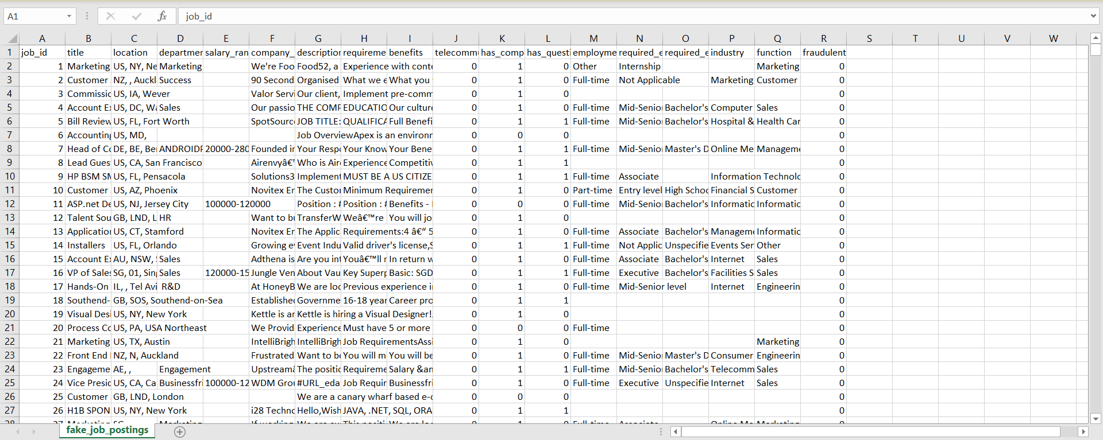
Dataset :- Fake Job Postings
Source :- Kaggle

Slide 6
Methodology:-
Exploring the dataset
Data cleaning, exploring, and pre-processing
Modeling
Evaluation
Prediction

Slide 7
Description of Modules
Data Collection: This module focuses on gathering relevant data for fraudulent job posting prediction. It may involve scraping job postings from online platforms, or obtaining data from other reliable sources. The collected data should include features that can help distinguish between legitimate and fraudulent postings.
Data Preprocessing: In this module, the collected data is cleaned and prepared for analysis. It includes tasks such as removing duplicates, handling missing values, and addressing inconsistencies in the data. Data preprocessing may also involve standardizing or normalizing numerical features and encoding categorical variables.

Slide 8
Feature Extraction: This module involves extracting informative features from the job posting data. It may include techniques such as natural language processing (NLP) to extract textual information like job titles, descriptions, and requirements. Feature extraction can also involve extracting numerical features like location, salary, or required experience from structured data.
Model Selection: In this module, different machine learning algorithms are evaluated and compared to identify the most suitable one for the problem at hand. Various models like logistic regression, decision trees, random forests, support vector machines, or neural networks can be considered. The selection is typically based on the dataset

Slide 9
Model Training: Once the model is selected, this module involves training the chosen machine learning algorithm on the preprocessed and engineered data. The dataset is divided into training and validation sets to estimate the model's performance. The model is trained by adjusting its parameters or hyperparameters using optimization techniques such as gradient descent or grid search.
Model Evaluation: This module assesses the trained model's performance using appropriate evaluation metrics. Common metrics for fraud prediction include accuracy, precision, recall, F1 score, and area under the ROC curve. The evaluation helps understand how well the model generalizes to unseen data and detects fraudulent job postings.

Slide 10
Algorithm and Techniques
Algorithm - Ensemble Classifier Model
Techniques - NLP Applications
Tokenization
Stop words removal
Lemmatization

Slide 11
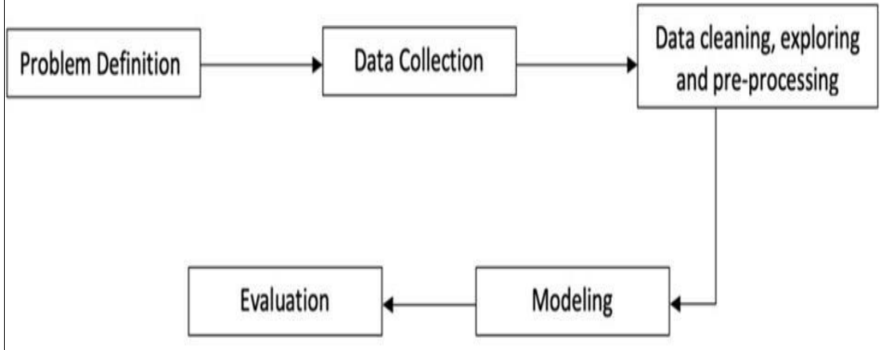
Architectural diagram

Slide 12
THANK YOU

